Slide 1

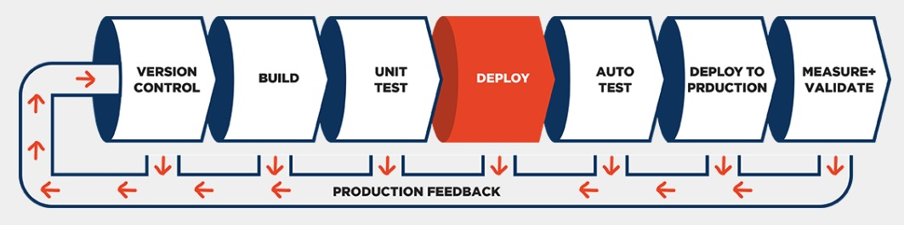
Qlik SENSE Cloud Continuous Delivery Pipeline
Jim Reed
Software Development Manager
Qlik

Slide 2
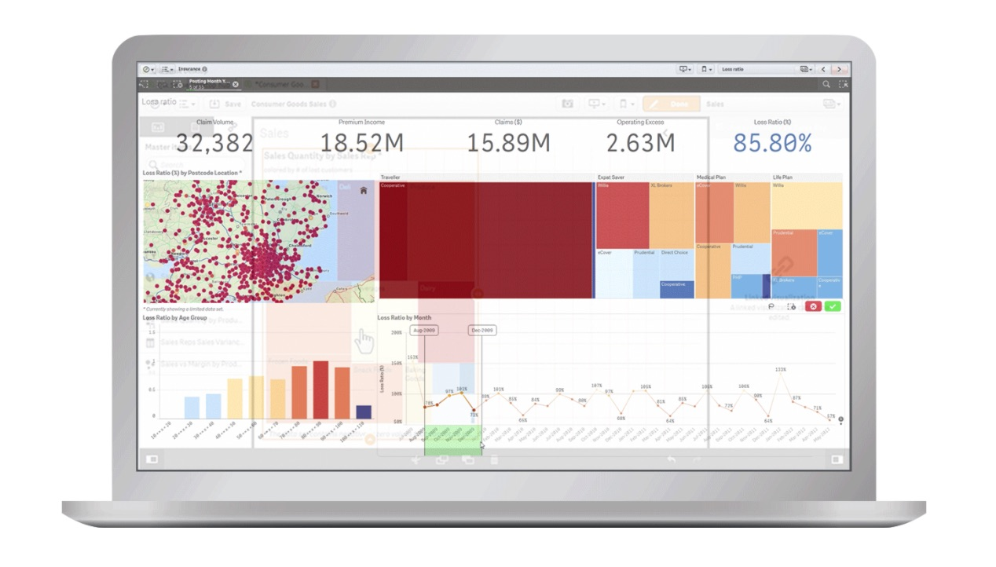
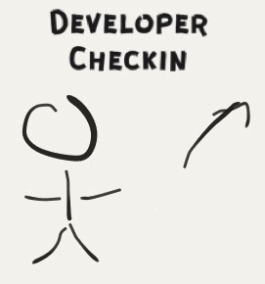
Continuous delivery pipeline
When a developer checks a change into master it can make it to prod later that day.

Slide 3
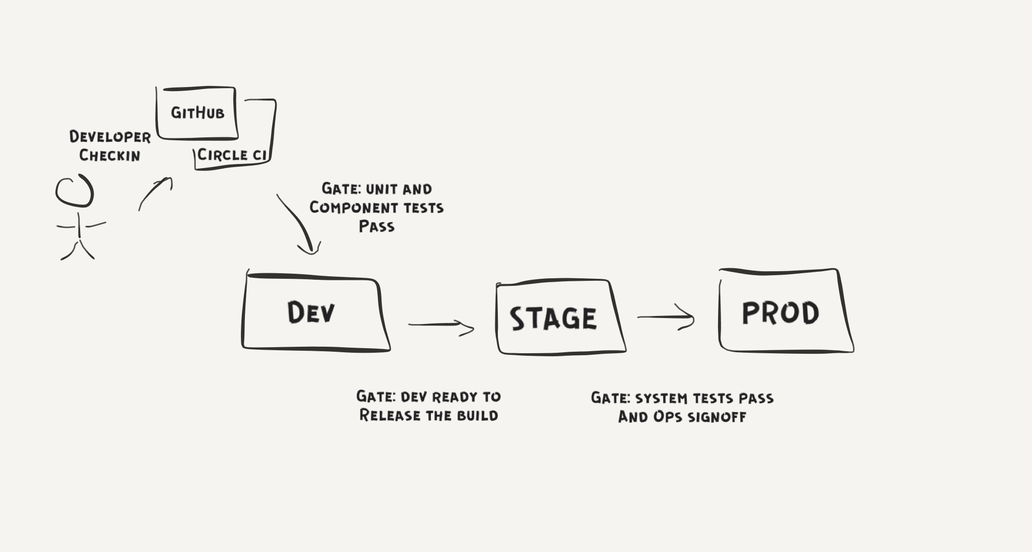
Continuous Delivery Pipeline
After check-in, testing occurs in multiple environments: Dev, Stage and Prod.

Slide 4
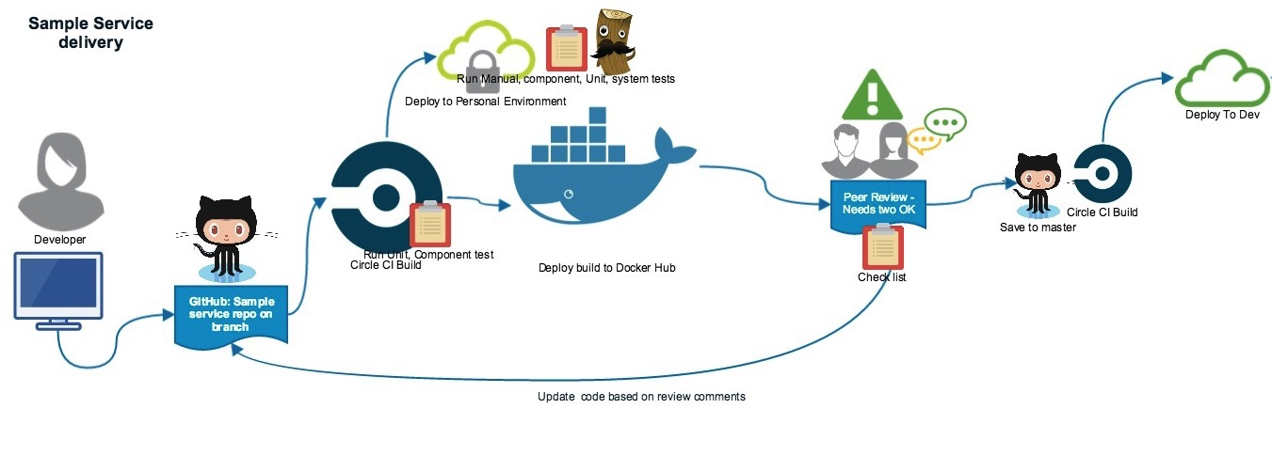
Before Merge to Master
Testing complete
Peer review complete
Automated tests included in PR
Ready for prod
If high risk, has a mitigation plan

Slide 5
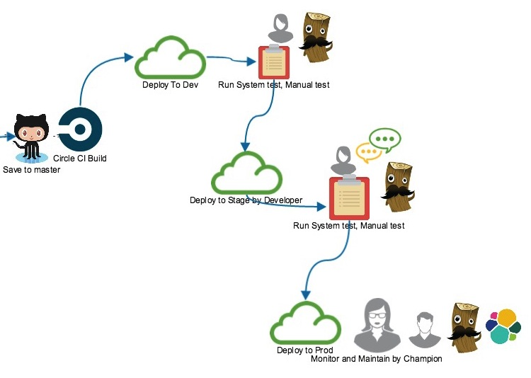
Ready For Dev?
Build successful
Unit tests, component tests and integration tests pass

Slide 6
Dev
Integration environment
Run system tests
Can run additional tests to confirm we are ready for prod

Slide 7
Ready For Stage?
System tests pass
No new regressions found
Dev team releases the build

Slide 8
Stage
Staging environment, just like prod
Rehearse /dry run prod deployment
Can run additional tests to confirm we are ready for prod
Practice rollback procedure

Slide 9
Ready for Prod?
System tests pass
Ops and QE sign-off
No outstanding issues

Slide 10
Deploy To Prod
Dev pairs with Ops to deploy to prod
Sanity test to verify deploy was successful
Dev and Ops monitor prod for issues
Gather evidence that change meets expectations

Slide 11
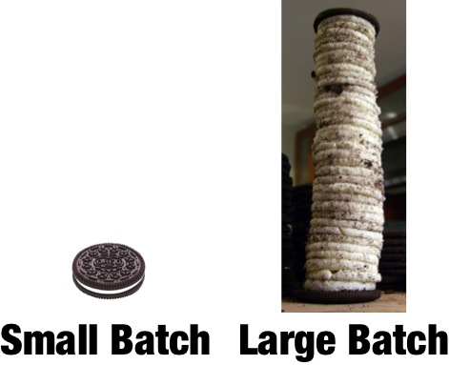
Benefit: More predictable releases
Switching to Continuous Delivery increased our release predictability. It is much easier to deploy small changes to prod. It’s easier to deploy without disruption. Don’t have to remember what you did two months ago. Don’t forget that extra deployment step.

Slide 12
Benefit: Better feedback
Quicker more focused feedback. Much easier to debug issues.

Slide 13
Benefit: Flexible
You get good at releasing if you do it every day. This really comes in handy when you have to deploy an emergency fix (or rollback) or quickly deliver a new feature. It’s pretty hard to rollback a month’s worth of code changes.

Slide 14
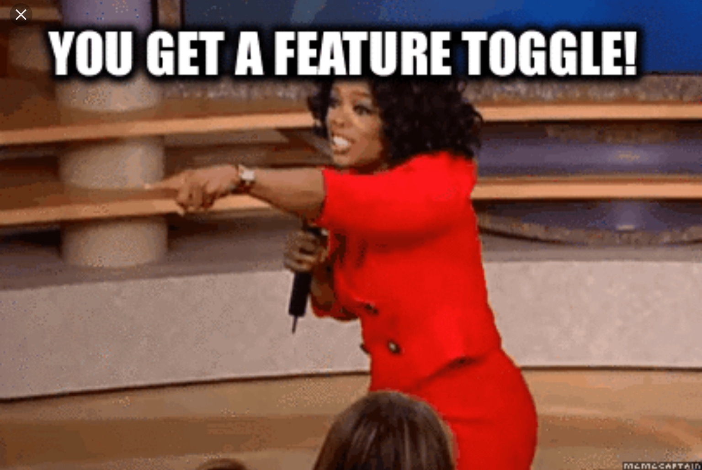
Feature flags
New features can be broken up into small pieces and delivered hidden under feature flags. Great to try things out in prod before your customers do. Great to make employees your guinea pigs.

Slide 15

Challenge: Too slow
Switching to micro-services and continuous delivery is a big investment. It was challenging initially to justify the slow down in new feature development.

Slide 16
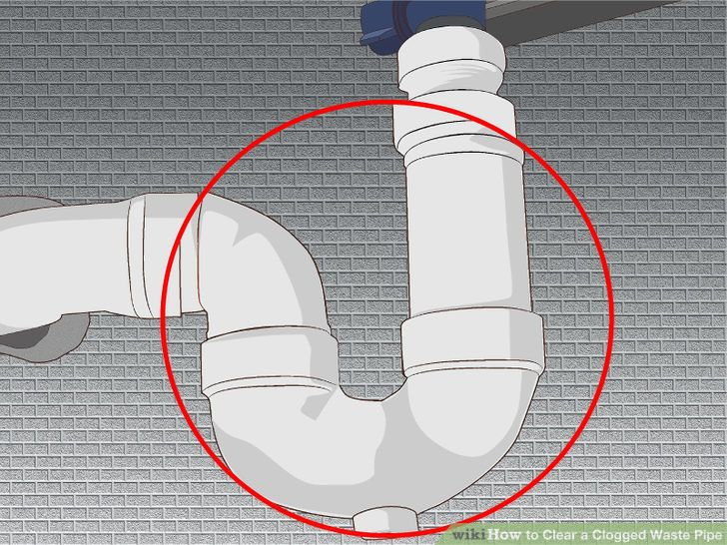
Challenge: Clogging the pipeline
Sometimes hard to have small changes, especially when refactoring. It’s especially hard when the changes have dependencies between services. These changes can clog the pipeline.

Slide 17

Challenge: It’s Hard to Stay Green
It’s a constant challenge to keep our system tests “green”.

Slide 18
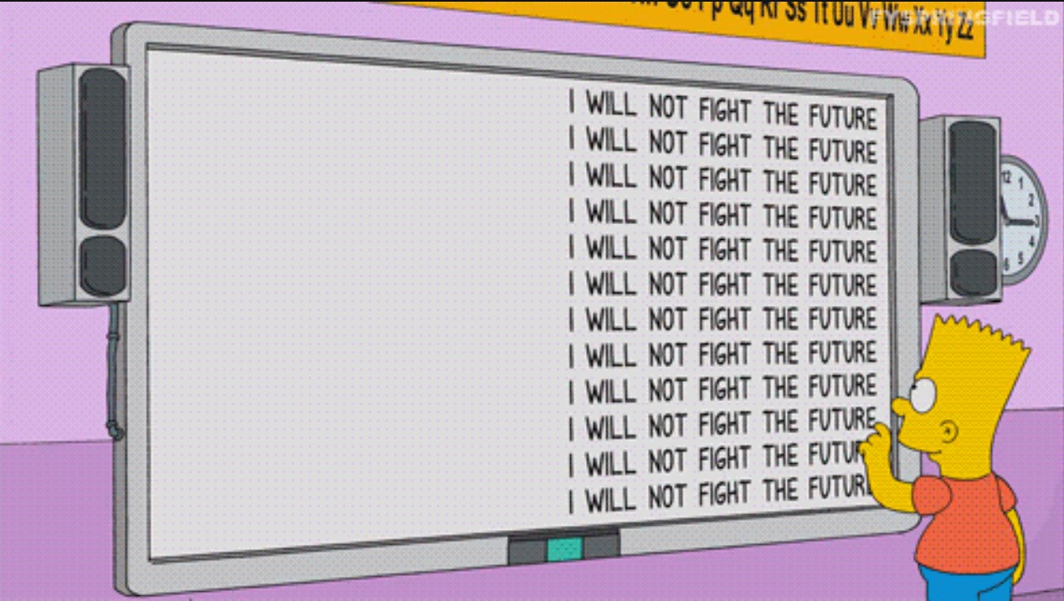
What’s Next?
Auto deploy to Production.
To get this we need:
Well defined micro-services
More/better automated testing
Better production monitoring
More automation/tooling

Slide 19
A/B Testing
Playground for innovation. Great opportunity to run experiments. We are not doing this yet but would like to soon.

Slide 20
thanks

Slide 21
Additional slides

Slide 22
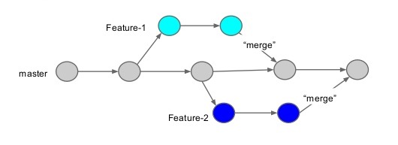
Started with Traditional releases
Didn’t start out with micro-services or continuous delivery. Developers developed features in a feature branch. Then released several months of work to production.

Slide 23

Too hard
Traditional releases were high risk, often delayed, very difficult to deploy, required outages.

Slide 24
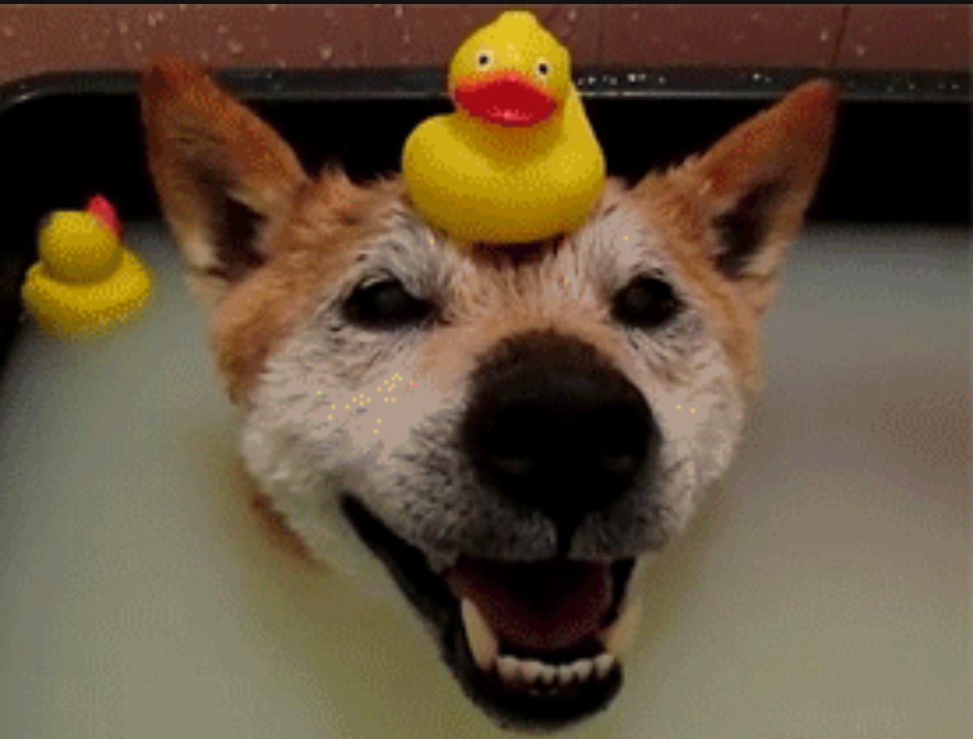
Challenge: Soak time
We sometimes soak changes in staging to mitigate risk. It’s no substitute for testing. It’s one more way to clog the pipeline.

Slide 25

When is a story done?
A) merged to master
B) deployed to develop
C) deployed to production
D) verified in production

Slide 26
When is a story done?
A) merged to master
B) deployed to develop
C) deployed to production
D) verified in production

